Slide 1
Bank Console application
Name: G. Sandhya
Batch Code:2021-6138

Slide 2
Introduction:
This is a Bank Management tool which is used to manage activities like creating Account in Bank, Deposit operation and withdraw operation etc, It is a menu driven program and it runs until the user exits.

Slide 3
Main menu available in this program:
Display All
Search By Account
Deposit
Withdrawal
Exit

Slide 4
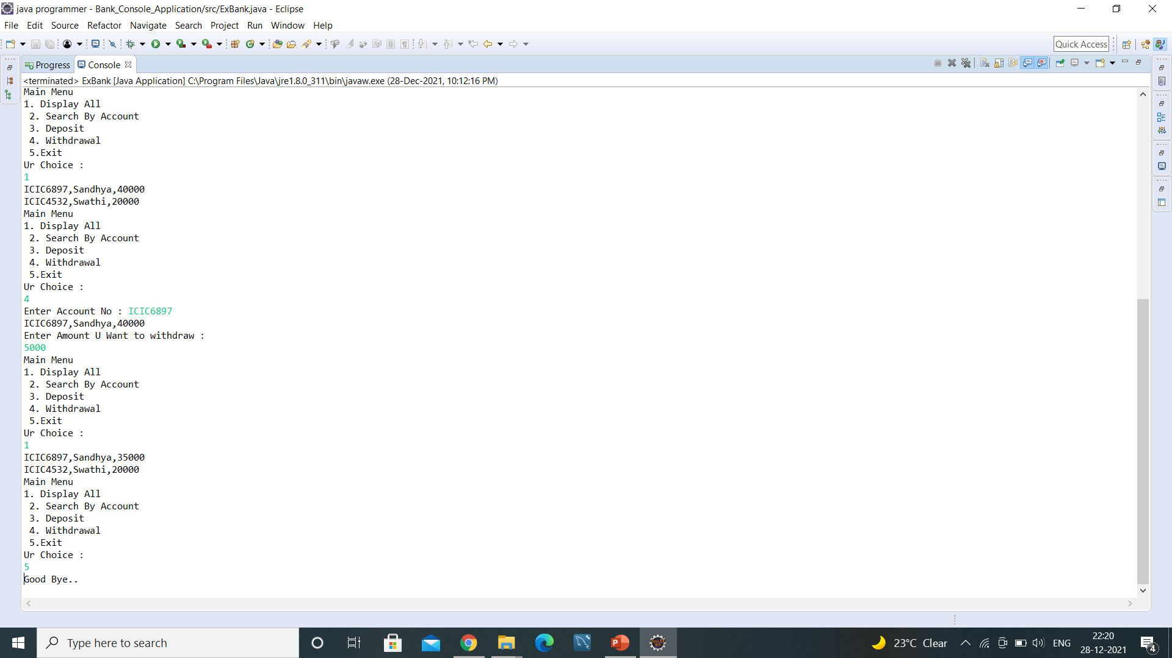
Output:

Slide 5


